Slide 1

RUNGTA COLLEGE OF DENTAL SCIENCES & RESEARCH
TITLE OF THE TOPIC-
ORTHODONTIC DIAGNOSIS
DEPARTMENT OF ORTHODONTICS AND DENTOFACIAL ORTHOPAEDICS

Slide 2
Specific learning Objectives
CORE AREAS | DOMAIN | CATEGORY
ESSENTIAL DIAGNOSTIC AID | AFFECTIVE | DESIRE TO KNOW
CASE HISTORY | COGNITIVE | MUST KNOW
ORTHODONTIC STUDY MODELS | PSYCHOMOTOR | NICE TO KNOW
DIAGNOSTIC SET UP | PSYCHOMOTOR | NICE TO KNOW
RECENT ADVANCES | AFFECTIVE | DESIRE TO KNOW

Slide 3
CONTENTS
Introduction
PART – I
Essential diagnostic aids
Supplemental diagnostic aids
CASE HISTORY :
Personal Detail, Chief Complaint, Medical History, Dental history,
Prenatal & Postnatal history, Family history.
General Examination : Body build
Extraoral Examination: Facial form, facial symmetry, facial profile,facial divergence, assessment of posterior jaw relationship, assessment of vertical skeletal relation, evaluation of facial proportion , examination of lips , examination of nose , examination of chin and nasolabial angle
Intraoral examination : Examination of Tongue , palate , gingiva , frenal attachment , tonsils & adenoids , Assessment of dentition , Functional examination , assessment of postural rest position and inter-occlusal clearance , methods used to record postural rest position , methods to measure inter-occlusal clearance , Evaluation of path of closure , assessment of repiration , examination of TMJ , Evaluation of Swallow & speech

Slide 4
PART – II
Orthodontic study models
Diagnostic setups
Supplemental diagnostic aids : Facial photographs as diagnostic aids , Electromyography , Radiographs in Orthodontics
Summary

Slide 5
INTRODUCTION
Orthodontic diagnosis deals with recognition of the various characteristics of the malocclusion.
◆ Orthodontic diagnosis should be based on scientific knowledge combined at times with clinical experience and common sense.
◆ Diagnosis include case history, clinical examination and other diagnostic aids such as study casts, radiographs and photographs.

Slide 6
◆ Comprehensive orthodontic diagnosis is established by clinical implementation called diagnostic aids.
◆ Orthodontic diagnostic aids are of two types namely’;
Essential diagnostic aids
Supplemental diagnostic aids

Slide 7
ESSENTIAL DIAGNOSTIC AIDS
They are clinical aids that are considered very important for all cases.
The following are essential diagnostic aids;
Case history
Clinical examination
Study models
Certain radiographs;
◆ Periapical
◆ Bitewing
◆ Panoramic
Facial photographs

Slide 8
Supplemental diagnostic aids
◆ They are certain aids that are not essential in all cases. They may require specialized equipments that an average dentist may not possess.
◆ The supplemental diagnostic aids include;
1-Specialized radiographs ex;
a-cephlometric radiographs
b-occlusal intra-oral films
c-selected lateral jaw views
d-cone shift technique
2.Electromyographic examination of muscle
Activity.

Slide 9
Hand wrist radiographs to assess bone age or maturation age.
Endocrine tests
Estimation of basal metabolic rate
6.Diagnostic set-up
7.Occlusograms

Slide 10
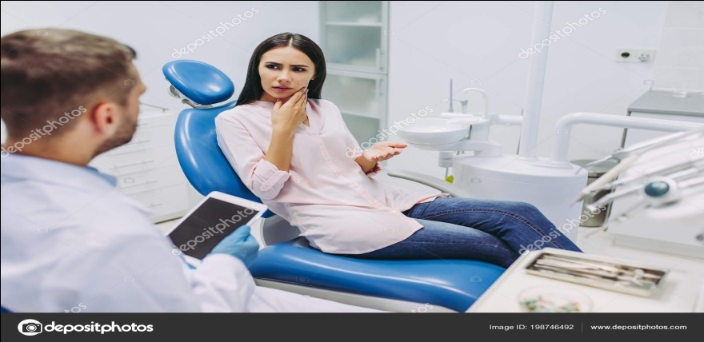
CASE HI STORY
◆ Case history involves eliciting and recording of relevant information from the patient and parent to aid in overall diagnosis of the case.
PERSONAL DETAILS:
NAME:The patient’s name should be recorded for the purpose of communication and identification.

Slide 11
AGE-The patients chronological age should be recorded. Age consideration helps in diagnosis as well as treatment planning.
◆ Growth modification procedures using functional and orthopaedic appliances are carried out during growth period.
◆ SEX-patient’s sex should be recorded in case history.
◆ This is important in planing treatment, as the timing of growth events such as growth spurts is different in males and females.

Slide 12
◆ ADDRESS AND OCCUPATION-Recording of address and occupation helps in evaluation of socio-economic status of the patient and the parents.
◆ CHIEF COMPLIANT -The patient’s chief compliant should be recorded in his/ her own words.
◆ This help the clinician in identifying the priorities
and the desires of the patient.

Slide 13
◆ MEDICAL HISTORY- Full medical history is recorded before orthodontic treatment.
◆ Few medical conditions contraindicate the use of orthodontic appliances such as;
Epilepsy
History of blood dyscrasias
Diabetic patient
Rheumatic fever
Cardiac anomalies
Physically and mentally handicapped children

Slide 14
◆ The medical history should include information on drug usage.
◆ The use of certain drugs like aspirin may impede orthodontic tooth movement.
◆ DENTAL HISTORY -It includes information on the age of eruption of the deciduous and permanent teeth,decay,history of extraction, restoration and trauma to dentition.
◆ Past dental history helps in evaluation of patient and parent’s attitude towards treatment.

Slide 15
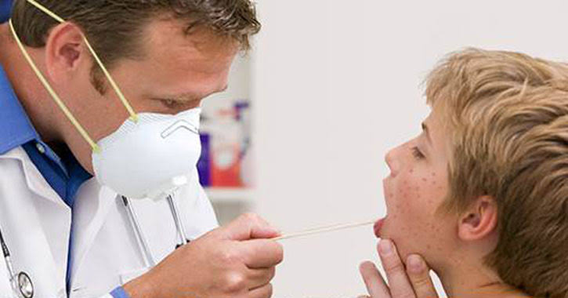
◆ PRENATAL HISTORY- It include information on the condition of the mother during pregnancy and the type of delivery.
◆ Forceps delivery predispose to TMJ injuries that can result mandibular growth retardation.
◆ Drugs like thalidomide or affectation with some infection during pregnancy like german measles can results in congenital deformities of child.

Slide 16

◆ POST NATAL HISTORY –It includes information on the type of feeding, presence of habits and on the milestones of normal development.
◆ FAMILY HISTORY- class II, classIII malocclusions and congenital conditions such as clefts of lip & palate are inherited.
◆ Family history should record details of malocclusion existing in other members of the family.

Slide 17
GENERAL EXAMIATION
◆ Height and weight-They provide clue to the physical growth and maturation of the patient.
◆ Gait-(way a person walks) Abnormalities of gait are usually associated with neuromuscular disorders that may have a dental correlation.
◆ Posture-(way a person stands)Abnormal postures can predispose to malocclusion due to alteration in maxillo-mandibular relationship.

Slide 18
Body build (physique)
◆ A)Aesthetic-thin physique and narrow dental arches.
◆ B)Plethoric-obese with large square dental arches
◆ C)Athletic-normally built, neither thin nor obese. normal sized dental arches.

Slide 19
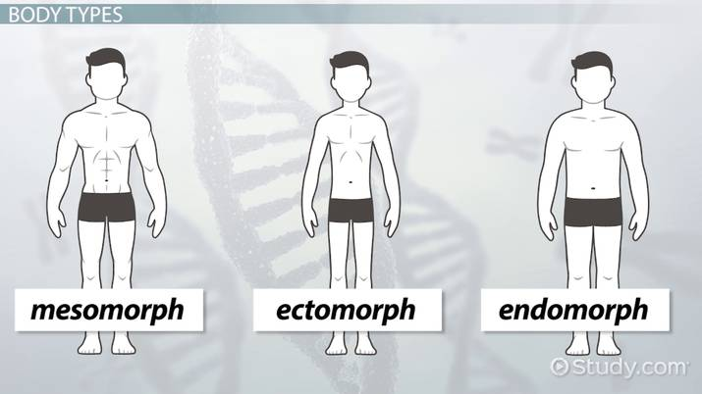
SHELDEON CLASSIFICATION OF BODY BUILD
A)ECTOMORPHIC-Tall and thin physique
B) MESOMORPHIC-Average physique
C)ENDOMORPHIC-Short and obese physique.

Slide 20
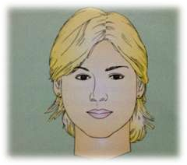
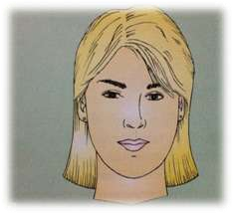
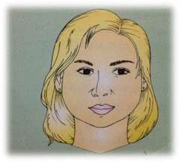
EXTRA ORAL EXAMINATION
SHAPE OF THE HEAD:
◆ A)MESOCEPHALIC-average shape of the head. posses normal dental arches.
◆ B)DOLICOCEPHALIC-long and narrow head . They have narrow dental arches.
◆ C)BRACHYCEPHALIC-broad and short head, broad dental arches.

Slide 21
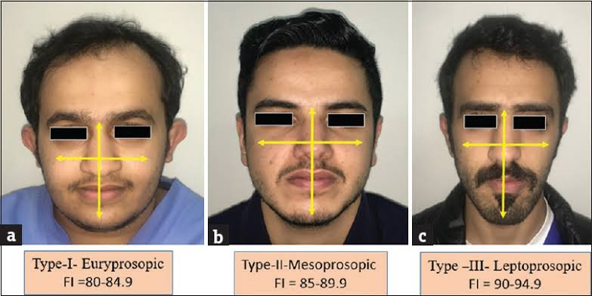
FACIAL FORM
A)MESOPROSOPIC-average normal face form
B)EURYPROSOPIC-face is broad and short
C)LEPTOPROSOPIC-long and narrow face form

Slide 22
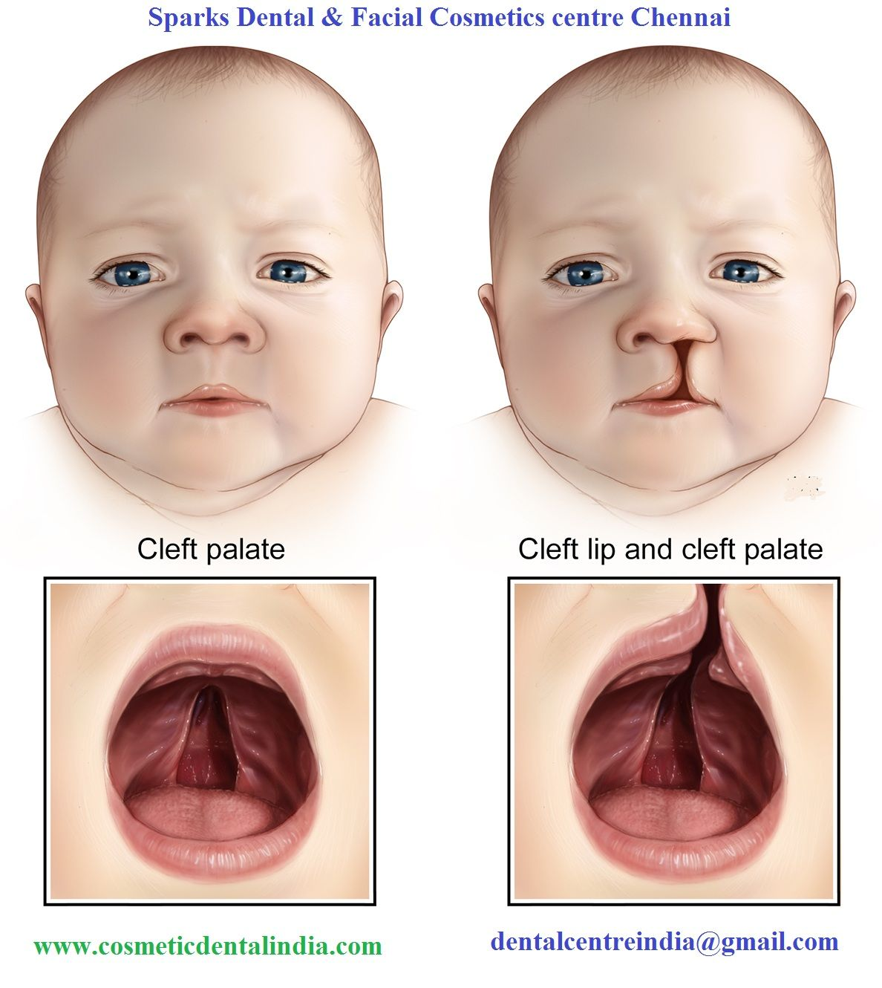
FACIAL SYMMETRY
◆ The patient’s facial symmetry is examined to determine disproportions of the face in transverse and vertical planes. Gross facial asymmetry can occur as a result of:
◆ A. congenital defects
◆
.

Slide 23
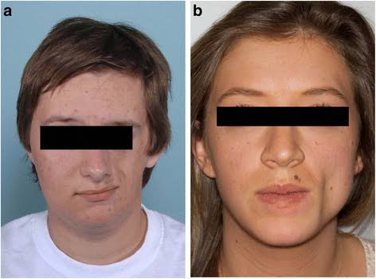
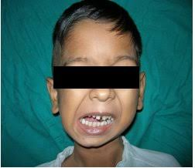
B. hemi-facial atrophy/hypertrophy
C.unilateral\condylar ankylosis and hyperplasia.

Slide 24
FACIAL PROFILE
◆ The facial profile is examined by viewing the patient from the side. the facial profile helps in diagnosing the gross deviation of maxillo- mandibular relationship. the profile is assessed by joining the following two reference lines.
A line joining the forehead and the soft tissue point A(deepest point in curvature of upper lip)
A line joining point A and the soft tissue pogonion(most anterior part of the chin).

Slide 25
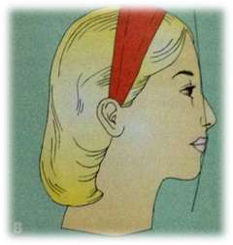
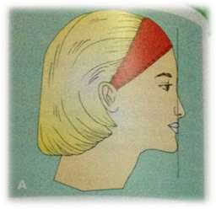
◆ STRAIGHT PROFILE-the two lines form nearly straight line.
◆ CONVEX PROFILE-the two lines form an angle with concavity facing the tissue.
◆ This kind of profile occurs as a result of prognathic maxilla retrognathic mandible as seen in CLASS II, DIVISON 1 MALOCCLUSION.
CONVEX PROFILE
STRAIGHT PROFILE

Slide 26
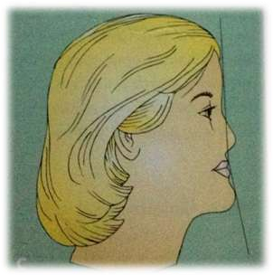
◆ CONCAVE PROFILE-the two reference lines form an angle with convexity towards tissue.
◆ This type of profile is associated with a prognathic mandible or retrognathic maxilla as in CLASS III MALOCCLUSION.

Slide 27
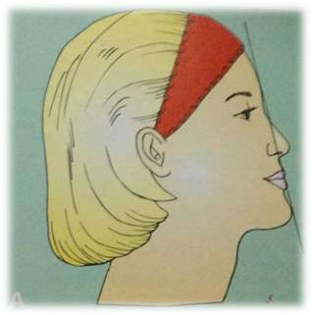
FACIAL DIVERGENCE
◆ Facial divergence is defined as anterior or posterior inclination of the lower face relative to the forehead.
◆ ANTERIOR DIVERGENT-A line drawn between the forehead and the chin is inclined anteriorly towards the chin..

Slide 28
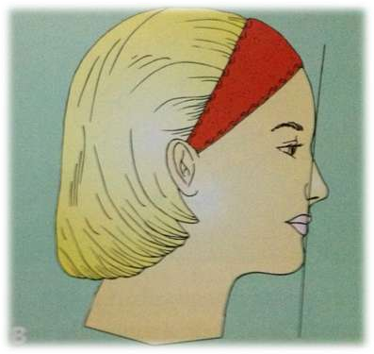
POSTERIOR DIVERGENT
◆ A line drawn between the forehead and chin slants posteriorly towards chin.

Slide 29
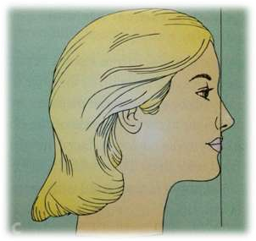
◆ STRAIGHT/ORTHOGNATHIC
◆ The line between the forehead and the chin is
straight or perpendicular to the floor.
◆ The facial divergence is to a large extend influenced by patient’s ethnic and racial background.

Slide 30
ASSESSMENT OF POSTERIOR JAW RELATIONSHIP
◆ It can be assessed clinically.
◆ Ideally maxillary skeletal base is 2-3 mm ahead of the mandibular skeletal base when the teeth are in occlusion.
◆ Estimation is done by placement of index and middle fingers at the soft tissue point A and point B respectively.

Slide 31
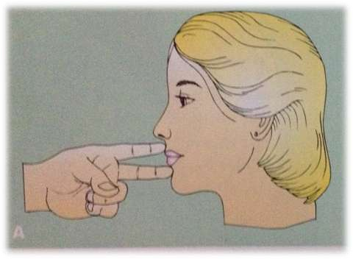
◆ In skeletal CLASS II PATIENTS, the index finger I s anterior to middle finger or the hand points upwards.

Slide 32
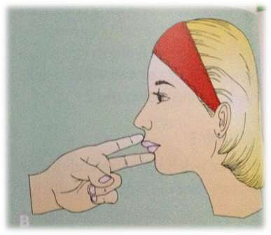
◆ In a skeletal CLASS III patient, the middle finger is ahead of the forefinger or the hand points downwards.

Slide 33
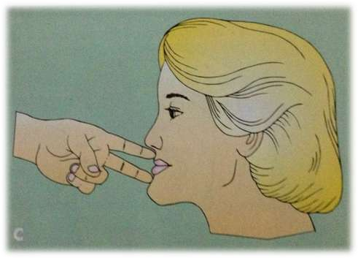
◆ In a patient with CLASS I skeletal pattern the hand is at an even level.

Slide 34
ASSESSMENT OF VERTICAL SKELETAL RELATIONSHIP
◆ The vertical skeletal relationship assessed by studying the angle formed between the lower border of the mandible and the Frankfort horizontal plane(a line between the most superior point of external auditory meatus and inferior border of orbit)
◆ Normally the two planes intersects at the occipital region.
◆ In case the two planes meets beyond the occipital region, it indicates a low angle case or a horizontal growing face.
◆ If two planes meet anterior to occipital region it indicates a high angle case or a vertical growing face.

Slide 35
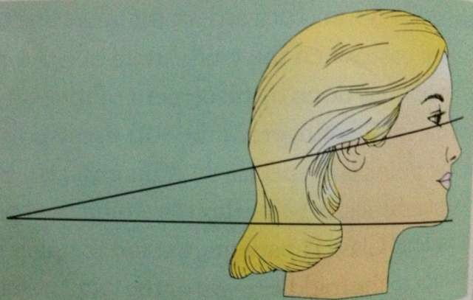
Assessment of vertical facial height

Slide 36
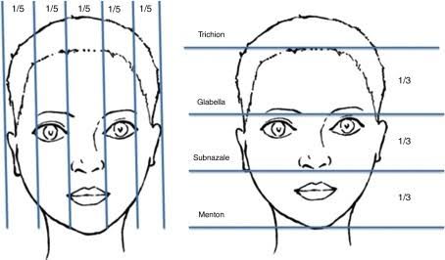
EVALUATION OF FACIAL PROPORTIONS
◆ A well proportioned face can be divided into three equal vertical thirds using four horizontal planes at the level of the hair line, the supra orbital ridge, the base of the nose and the inferior border of chin
◆ Within the lower face, the upper lip occupies A third of the distance while chin occupies the rest of the space.

Slide 37
SUMMARY
Orthodontic examination and diagnosis start first with formal and
informal meeting with child and parents.
A detailed history is followed by a detailed, intricate examination of physical growth, face,soft tissues and oral cavity, including functions of stomatognathic
systems.
A close and diligent clinical study evaluation of malocclusion and
functional examination is a critical component of orthodontic diagnosis.
A detailed examination cannot be done in a hurry and
would require each of the listed components to be recorded and
evaluated for its possible impact on oral health and orthodontic
treatment.
The clinical examination is followed by making required
records and investigations leading to a comprehensive diagnosis and
treatment plan.

Slide 38
REFERENCES
Textbook of Orthodontics – Gurkeerat Singh, Jaypee Brothers; 2nd Edition
Orthodontics – The Art and Science, S.I Bhalajhi, AryaMedi Publishing; 7th Edition
Textbook of Orthodontics – Sridhar Premkumar, Elsevier; 1st Edition
Orthodontics: Diagnosis and Management of Malocclusion and Dentofacial Deformities – O.P Kharbanda, Elsevier; 1st Edition

Slide 39
Question & Answer Session

